Slide 1
Integers
Integers are whole numbers and their opposites (positive numbers, zero, and negative numbers). Negative numbers are the numbers less than zero. They can be shown on a number line.
-5
-4
-3
-2
-1
0
1
2
3
4
5
neither positive
nor negative
The opposite of a number is the number that is the same distance from 0 on a number line, but on the opposite side of 0. The opposite of a positive number is a negative number, and the opposite of a negative number is a positive number.

Slide 2
Example
-4 is 4 units from 0 4 is 4 units from 0
-4 and 4 are opposites
The sum of two opposites is 0.
Example
-4 + 4 = 0 4 + (-4) = 0
-125 + 125 = 0 125 + (-125) = 0
245 + (-245) = 0 - 245 + 245 = 0

Slide 3
Integers In Real Life Situations
Integers can be used for computation in real life situations. Some keywords that indicate positive integers are gained, increased, rose, above, more, and up.
Some keywords that indicate negative integers are lost, less, decreased, dropped, below. and down. You can use keywords in a problem to solve for missing information.
Example
What integer is represented by the red words in the following sentence?
Between 2:00 p.m. and 10:00 p.m., the temperature dropped 12 degrees.
The integer that represents dropped 12 degrees is -12.

Slide 4
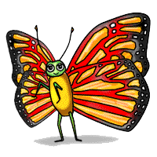
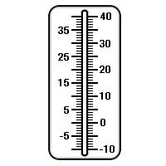
Example
Mackenzie is tracking temperatures. At 6:00 a.m. the temperature was at 00 C. The following thermometer shows the temperature at 1:00 p.m. What integer is represented by the temperature, in oC, at 1:00 p.m.?
The temperature on the thermometer is -9oC.
The temperature dropped 9oC between 6:00 a.m. and 1:00 p.m.

Slide 5
Practice Problems
Directions: Write the integer that is represented by the red words in each sentence.
1. The temperature decreased 18oF from 1:00 p.m. to 7:00
p.m. _________
2. Katie's checking account dropped $126.54. _________
3. Erik's dog gained 6 pounds. _________
4. The Nets lost by 7 points. _________
5. After payday, Deena's account increased $565.95. ________
6. The highest point in New Jersey is 1,803 feet above sea
level. __________
7. Kari lost $0.50 in the vending machine. __________

Slide 6
THE END

