Slide 1
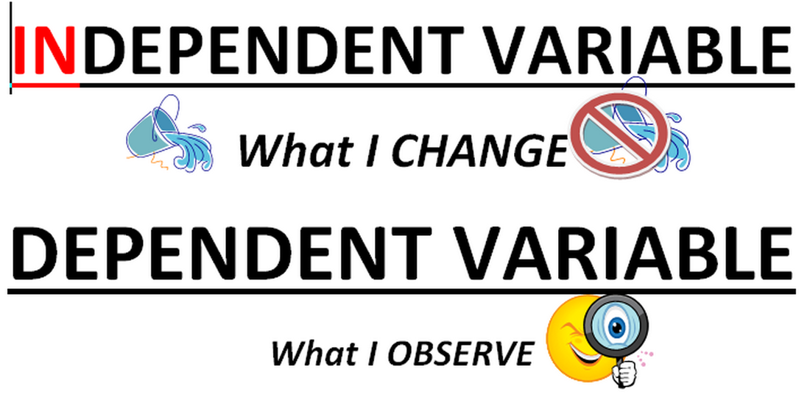

Slide 2
Kinds of Variables
Independent Variable – something that is changed by the scientist
What is tested
What is manipulated
Dependent Variable – something that might be affected by the change in the independent variable
What is observed
What is measured
The data collected during the investigation

Slide 3
Question 1

Slide 4
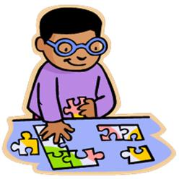
Students of different ages were given the same jigsaw puzzle to put together. They were timed to see how long it took to finish the puzzle.
Identify the independent and dependent variables in this investigation.

Slide 5
What was the independent variable?
Ages of the students
Different ages were tested by the scientist

Slide 6
What was the dependent variable?
The time it to put the puzzle together
The time was observed and measured by the scientist

Slide 7
Question 2

Slide 8
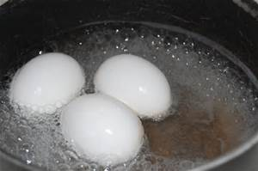
Hypothesis= If the temperature of water is higher, then an egg will boil faster.

Slide 9
Hypothesis= If the temperature of water is higher, then an egg will boil faster.
Independent variable – temperature of water
Dependent variable – time to cook an egg

Slide 10
Identify the Independent and Dependent Variables:
What brand of soda contains the most caffeine?

Slide 11
Identify the Independent and Dependent Variables:
What brand of cereal contains the most sugar?

Slide 12
Identify the Independent and Dependent Variables:
What type of bubblegum makes the biggest bubbles?

Slide 13
Identify the Independent and Dependent Variables:
What type of toothpaste makes teeth the whitest?

Slide 14
Identify the Independent and Dependent Variables:
What type of dishwashing soap makes the biggest bubbles?

Slide 15
Identify the Independent and Dependent Variables:
What grade of middle school students (6th, 7th, or 8th) can jump the highest?

Slide 16
Identify the Independent and Dependent Variables:
Does fertilizer helps plants grow the tallest?

Slide 17
Identify the Independent and Dependent Variables:
Which grade of middle school students (6th, 7th, or 8th) can shout the loudest?

Slide 18
Another example:

Slide 19
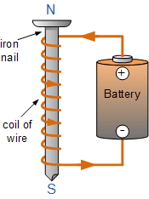
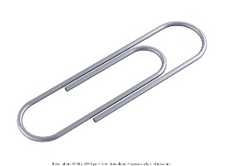
An investigation was done with an electromagnetic system made from a battery and wire wrapped around a nail. Different sizes of nails were used. The number of paper clips the electromagnet could pick up was measured.
Identify the independent and dependent variables in this investigation.

Slide 20
Independent variable:
Sizes of nails
These were changed by the scientist

Slide 21
Dependent variable:
Number of paper clips picked up
The number of paper clips observed and counted (measured)

Slide 22
Last one:

Slide 23
The temperature of water was measured at different depths of a pond.
Identify the independent and dependent variables in this investigation.

Slide 24
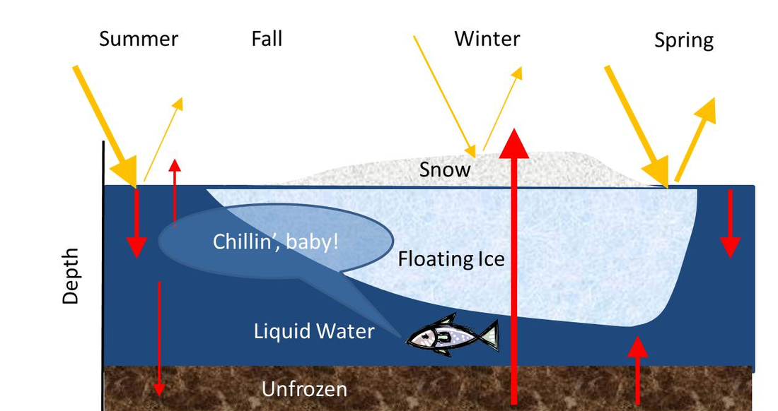
The temperature of water was measured at different depths of a pond.
Independent variable – depth of the water
Dependent variable – temperature

Slide 25
Designing Investigations

Slide 26
PROBLEM: Does a ball bounce higher if it drops a greater distance from the ground?
Design an investigation to test this hypothesis.
Identify the following parts of your experiment:
Independent variable (What exactly will be changed? How will it be changed?)
Dependent variable (What exactly will be measured? How will it be measured?)
Constants
If time, make a Hypothesis, conduct the Experiment, gather Data, and make a Conclusion

