Slide 1
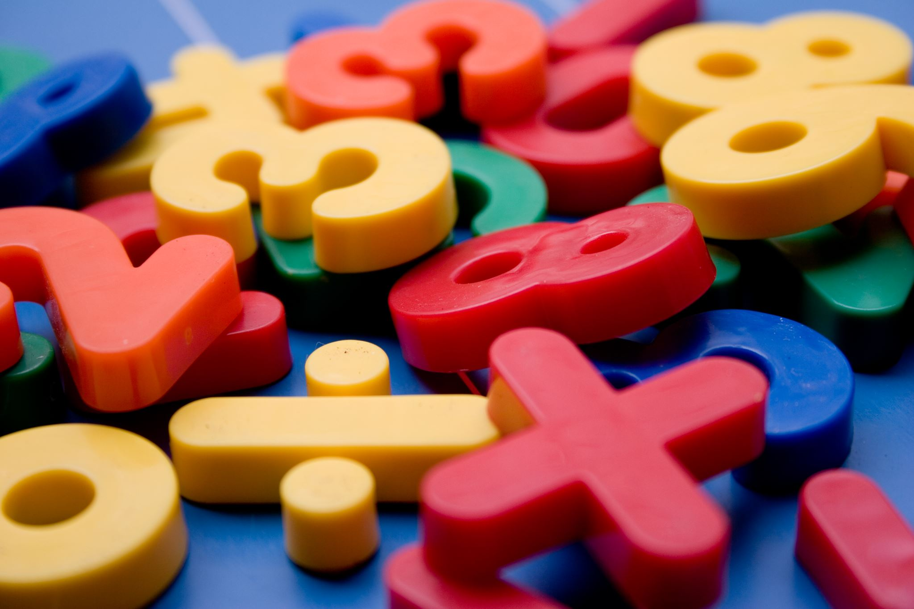
Math N8 Decimals Week 3
Mathématiques N8 décimaux
Semaine 3

Slide 2
Monday, January 24th Day 10
Lundi, 24 janvier
Jour 10

Slide 3
Relate Multiplication to Division

Slide 4
Monday, Jan. 24th Mental Math #1
Mental Math #1
1. 7 x 8 = 6. 21 x 200 =
2. 70 x 8 = 7. 600 ÷ 2 =
3. 7 x 80 = 8. 60 ÷ 2 =
4. 500 – 198= 9. 6 ÷ 2 =
5. Half of 380 = 10. 0.6 ÷ 2

Slide 5
Write an addition and subtraction related facts for the following numbers
1,2,3
4,5,9
23,44,67
→ 3-2=1
→1+2=3
→ 9-5=4
→5+4=9
→ 67-44=23
→44+23=67

Slide 6
Today we are going to learn how to divide by thinking about multiplication.
Just like addition and subtraction sentences are opposites or inverses, so is multiplication and division.

Slide 7
What is a multiplication sentence we can write for this array?
2 rows of 9 → 2 x 9 = 18
9 rows of 2 → 9 x 2 = 18

Slide 8
What if I started with 18 and I wanted groups of 2?
18 ÷ 2 = ____
9

Slide 9
What if I started with 18 and I wanted groups of 9?
18 ÷ 9 = ____
2

Slide 10
So, the division/multiplication fact family for 9, 2, 18 is…
9 x 2 = 18
2 x 9 = 18
18 ÷ 2 = 9
18 ÷ 9 = 2

Slide 11
Let’s practice writing a division equation we can use to solve…
5 x 9 = 45
45 ÷ 5 = 9
How did you know where to put the numbers in the division equation?

Slide 12
Let’s solve for the missing digit
56 ÷ 7 = ___
7 x __ = 56
How could you draw an array or equal groups to solve for the missing digit if you did NOT know your multiplication facts ?

Slide 13
Use the “Think Multiplication” strategy to solve…
10
50 ÷ 5 = _____
5 x ____= 50
10

Slide 14
Monday Work: Complete and submit the following questions and the worksheet on the next slide
Write a multiplication/division fact family for: 5,6,30
Write a division problem for: 4 x 3 = ___
Write a multiplication problem for: 24 ÷ 6 = ___

Slide 15
