Slide 1
Multiplying Fractions
Copy the outcome in your scribbler then read the achievement indicators.
N6: Demonstrate an understanding of multiplying and dividing positive fractions and mixed numbers, concretely, pictorially and symbolically.
Achievement Indicators
Identify the operation required to solve a given problem involving positive fractions.
Provide a context that requires the multiplying of two given positive fractions.
Estimate the product of two given positive proper fractions to determine if the product will be closer to 0, one half, or 1.
Express a given positive mixed number as an improper fraction and a given positive improper fraction as a mixed number.
Model multiplication of a positive fraction by a whole number concretely or pictorially and record the process symbolically.
Model multiplication of a positive fraction by a positive fraction concretely or pictorially using an area model and record the process symbolically.
Generalize and apply rules for multiplying and dividing positive fractions, including mixed numbers.

Slide 2
Multiplying Fractions Review these terms.
Fraction Words
repeated addition
numerator
denominator
proper fraction
mixed number
improper fraction
whole number
equivalent fractions

Slide 3
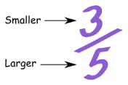
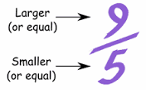
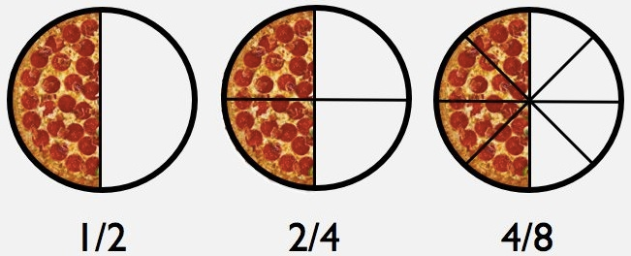
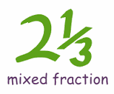
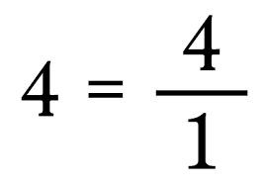
Key Words-Fraction Terms Copy these examples into your math scribbler.
Proper Fraction
Improper Fraction
Repeated Addition $\frac{1}{2}$ +$\frac{1}{2}$ + $\frac{1}{2}$
Equivalent Fraction
Whole number
represented as a
fraction.
Mixed Number Fraction

Slide 4
Multiplying: Copy these 3 examples into your math scribbler.
Whole Number x Fraction 4 x $\frac{1}{2}$
2. Fraction x Fraction $\frac{1}{2}$ x $\frac{1}{4}$
3. Mixed Number fractions x Mixed Number fraction 2$\frac{1}{2}$ x 3$\frac{1}{4}$

Slide 5
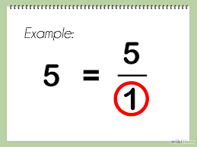
PART A: 1. Whole Number x Fraction
Note: All whole numbers can be represented as a fraction by inserting a 1 as its denominator.
Copy and solve into your math scribbler.
How would you represent these whole numbers as a fraction?
2 =
3 =

Slide 6
Multiplying Fractions 1. Whole Number x Fraction
When multiplying a whole number by a fraction, it is important to remember that one multiplies the numerator by the numerator and the denominator by the denominator as the example shows.
Note: Remember that all whole numbers can be represented as a fraction by inserting a 1 as its denominator.
**How would you simplify $\frac{9}{4}$ ?
Copy this example into your math scribbler.

Slide 7
Solve the following whole number x fraction equations. Simplify your answer.
1. 3 x $\frac{1}{2}$ = 2. 4 x $\frac{1}{3}$ =
3. 4 x $\frac{2}{3}$ = 4. 6 x $\frac{3}{2}$ =
5. $\frac{1}{2}$ x 3 = 6. $\frac{3}{4}$ x 2 =

Slide 8
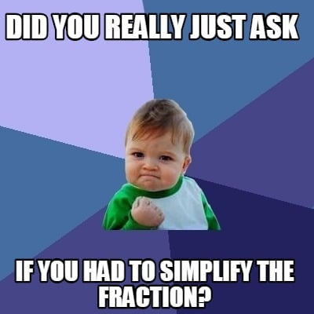
Practice
Multiplying Whole number x Fraction (symbolically)
Complete question # 16 in your math book on page 109.
You will need to simplify your answer
Remember to correct your answers using the math book.

Slide 9
Journal Question N6 #1

Slide 10
Model multiplication of a positive fraction by a whole number pictorially. Now that you know how to solve a multiplication equation that has a whole number x a fraction, you must now demonstrate how to model the equation.

Slide 11
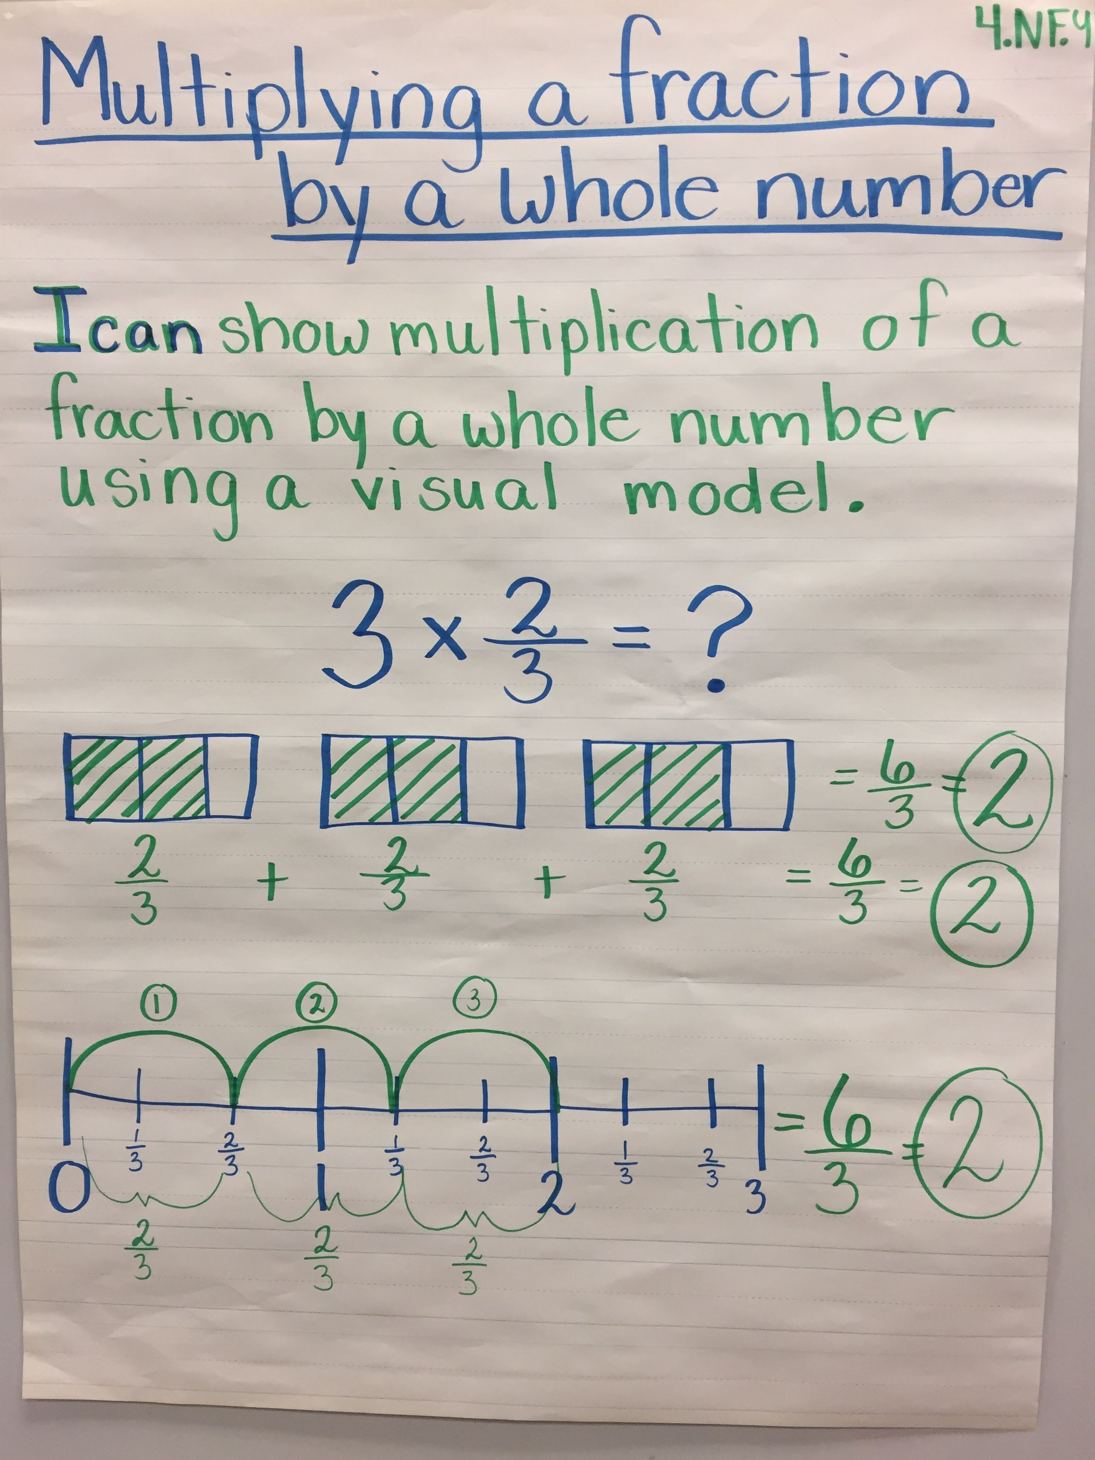
Example: Multiplying a fraction by a whole number with repeated addition and pictures. Copy these examples into your scribbler.

Slide 12
Watch the following 3 videos to ensure you understand how to model a whole number x fraction.
Repeated Addition/ Drawing fraction circles/
https://www.youtube.com/watch?v=964XKRVUnuQ
Note: this last video has 5 clips. Watch them all then attempt the practice lesson.
https://www.khanacademy.org/math/cc-fifth-grade-math/5th-multiply-fractions/imp-multiplying-fractions-and-whole-numbers/v/multiplying-fractions-by-whole-numbers-on-the-number-line

Slide 13
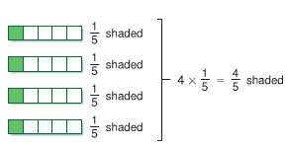
Please go to pages 105 - 107 in your math book. Copy notes and diagrams into your scribbler to ensure you understand how to model using the different strategies discussed.

Slide 14
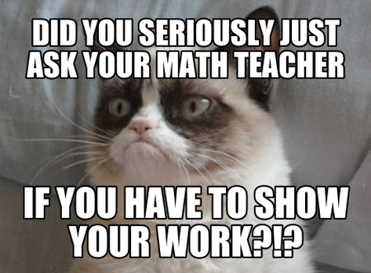
Practice Time
1) Complete questions #5, 6, 7, 8, 9, 10, 11, 14- a, d, and 17 on pages 108 & 109 in your math book.
2) Worksheet 3.1 – Using Models to Multiply Fractions and Whole Numbers (pages 50 and 51 in the Practice and Homework Book)

Slide 15
N6 Journal Question # 2

Slide 16
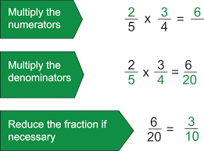
PART B 2. Multiplying Fraction x Fraction
When multiplying fractions, the math process is always numerator x numerator and denominator x denominator. Copy the example below in your scribbler.

Slide 17
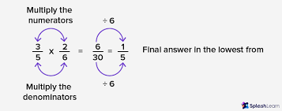
Solve the following fraction x fraction equations. Simplify when possible.
1. $\frac{1}{2}$ x $\frac{1}{4}$ 2. $\frac{1}{2}$ x $\frac{2}{3}$
3. $\frac{2}{5}$ x $\frac{1}{4}$ 4. $\frac{2}{3}$ x $\frac{3}{2}$

Slide 18
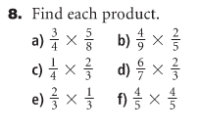
Practice
Complete question 8 on page 113 in your scribbler.
Remember to simplify your answers.

Slide 19
N6 Journal Question # 3

Slide 20
Multiplying fraction x fraction with the area model

Slide 21
Copy Example # 3 on page 112 in your math scribbler. Watch both videos and copy some of these examples into your scribbler.
https://www.youtube.com/watch?v=qg2u0bvHBGU
https://www.youtube.com/watch?v=k03OKmQaNU0

Slide 22
Practice
Complete questions # 6 a,b,c,d, *use 2 colors to represent image and #10 all on page 113.
Worksheet 3.2 – Using Models to Multiply Fractions (pages 52 and 53 from the Homework and Practice Book)

Slide 23
N6 Journal Question # 4

Slide 24
3.3 Multiplying Fractions
Read the Connect section on page 116 and take notes as needed.
Read Example 1- Focus on the benchmarks for reasonable products/answers.

Slide 25
Practice
Complete question # 7 a,b,c on page 118 in your scribbler.
NOTE: You have used Fraction Benchmarks for the past few years of your math. Estimation is another term that can be used here. Fraction benchmarks are:
0, $\frac{1}{2}$ , 1
2) Worksheet 3.3 – Multiplying Fractions (pages 54 and 55 in the Homework and Practice Book)

Slide 26
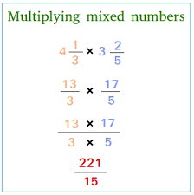
Part C 3. Mixed Number fractions x Mixed Number fraction 2$\frac{1}{2}$ x 3$\frac{1}{4}$
Multiplying Mixed Numbers
Copy down Example 3 on page 124 in your
math book! ESTIMATION IS KEY!!!

Slide 27
Watch the following 2 videos to ensure you understand how to solve a mixed number x a mixed number .
https://www.youtube.com/watch?v=HQ3EXyW36es
https://www.khanacademy.org/math/arithmetic/fraction-arithmetic/arith-review-mult-mixed-num/v/multiplying-mixed-numbers
Do the lesson at the end of the 2nd video ( Khan Academy)

Slide 28
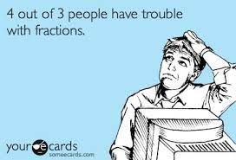
Practice!
Complete questions # 4 all, # 5 a,b,c, # 6 a,b,c, #7 all, # 8 all, # 9 a,b et # 11 a,b on page 125 in your scribbler.
2) Worksheet 3.4 – Multiplying Mixed Numbers (on pages 56 and 57 in the Homework and Practice Book)

Slide 29
Journal Question N6 #5

Slide 30
Multiplication Word Problems
Gabrielle filled 5 glasses with 3/4 of a litre of juice in each glass. Use a model or draw a picture to determine how much juice Gabrielle used. Write the operation symbolically.
In a gymnasium, ¼ of the people present are men, 1/3 are women, and the rest are children? If there are 240 people in the gymnasium, how many children are there?

Slide 31
N6 Journal Question # 6

